Slide 1

WELCOME TO THE BIT PLACEMENT CLUB
We are a college club dedicated to helping students excel in their careers. Join us to connect with industry professionals, gain valuable skills, and have fun!

Slide 2
About the BIT Placement Club
Industry Partnerships
Mission & Goals
Our Focus
From mock interviews to training sessions, we offer a wide range of activities that help members develop their professional skills and expand their networks.
Our mission is to empower students for successful career placements. We organize workshops, seminars, and networking events to ensure our members are well-prepared.
We collaborate with leading companies to provide training opportunities, CV building programs, and some exclusive contacts for our members.

Slide 3
Benefits Of Joining
Career Advantage
Access to job postings, resume reviews, and interview preparation sessions to enhance your chances of landing your dream job.
Networking Opportunities
Connect with industry professionals, alumni, and like-minded students through our events and workshops.
Personal Growth
Develop leadership skills, improve your communication abilities, and gain valuable experience to boost your overall professional development.

Slide 4
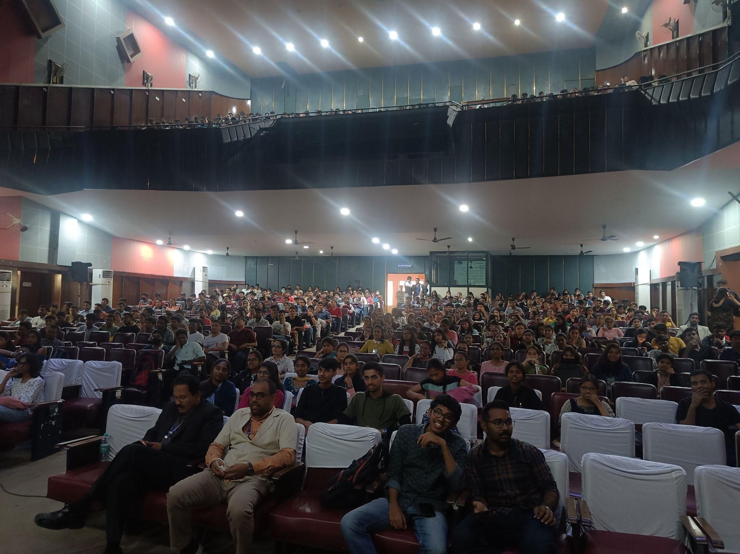
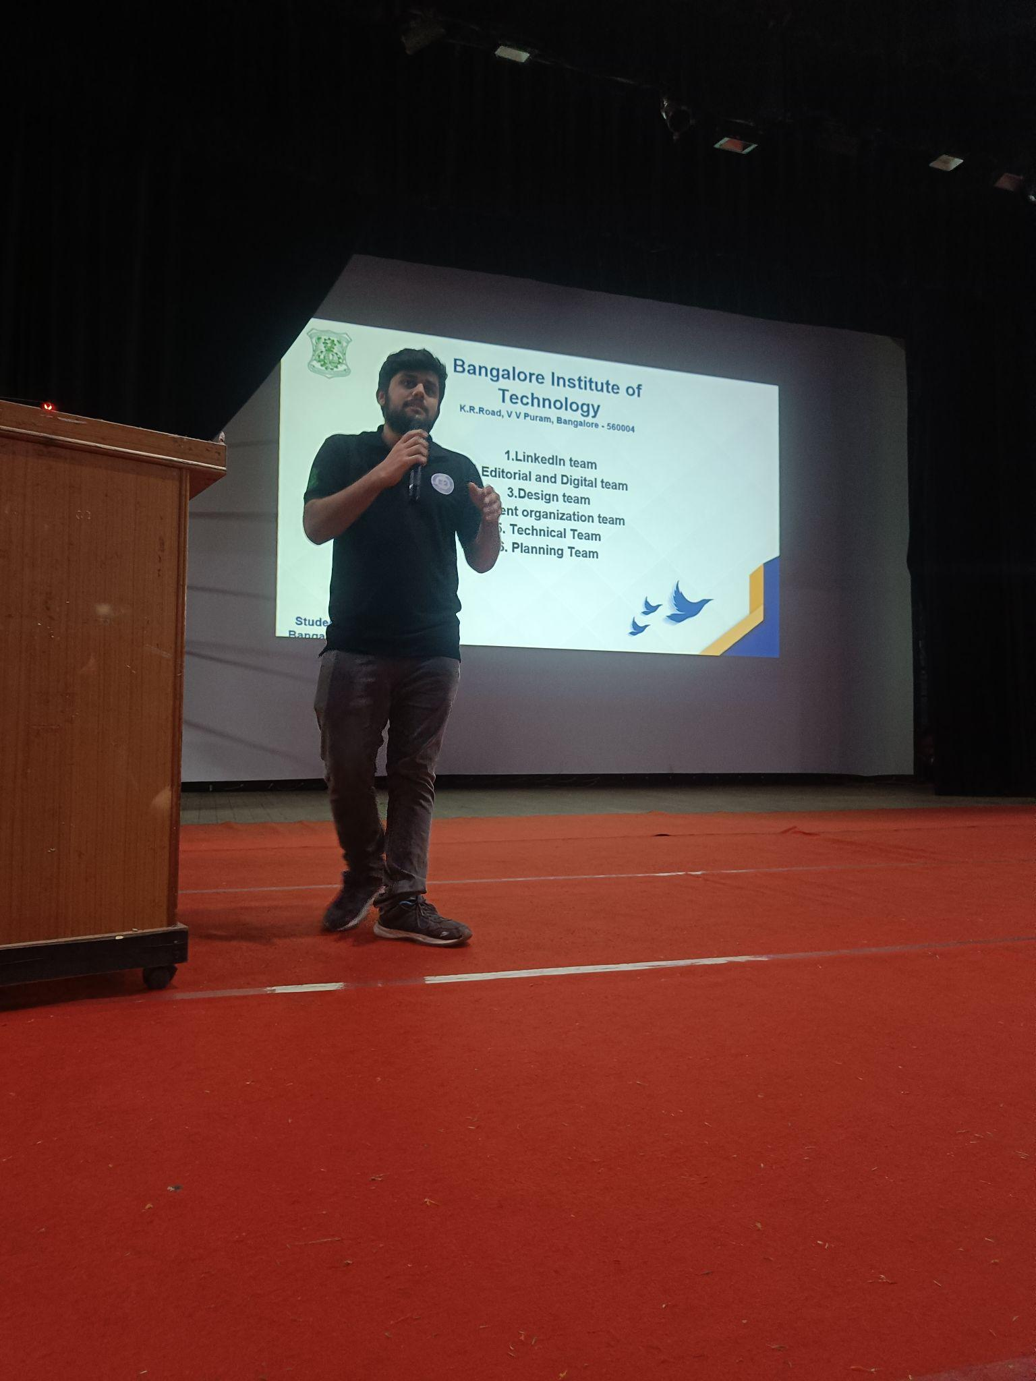
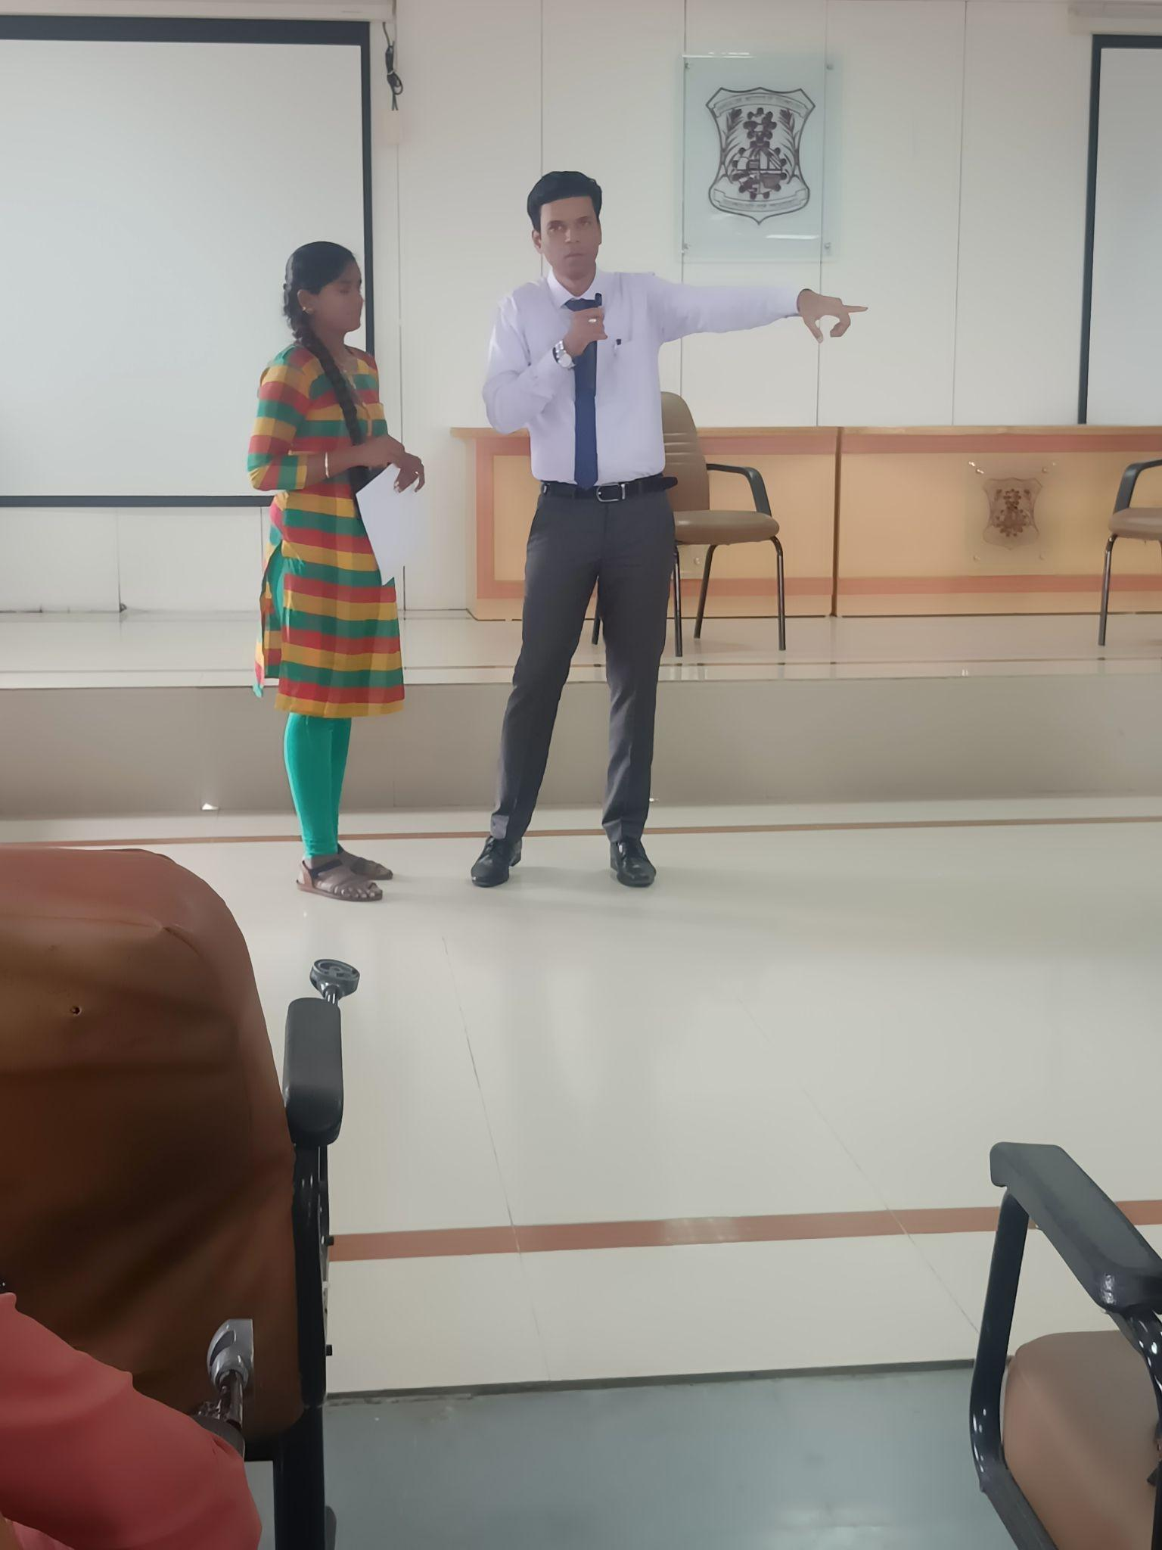
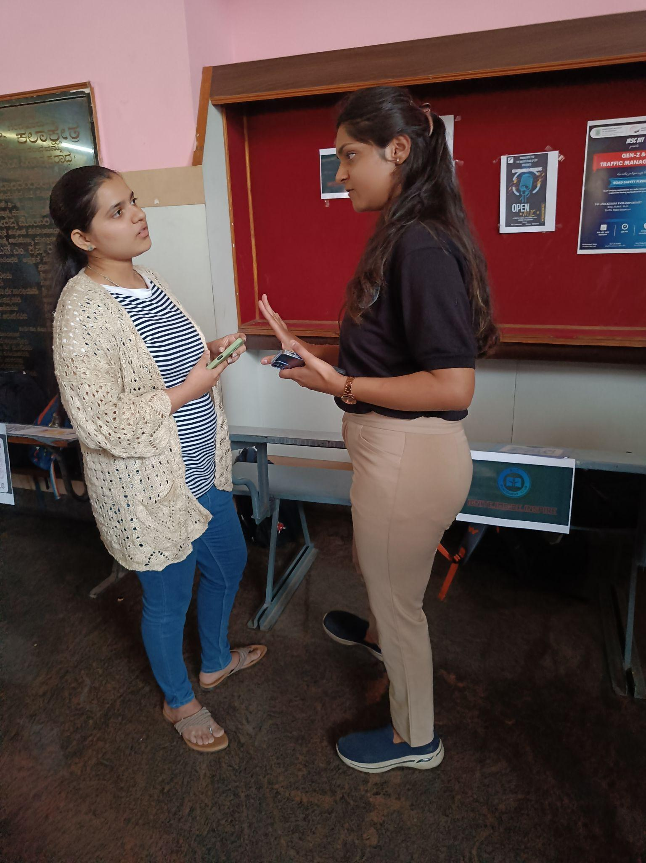
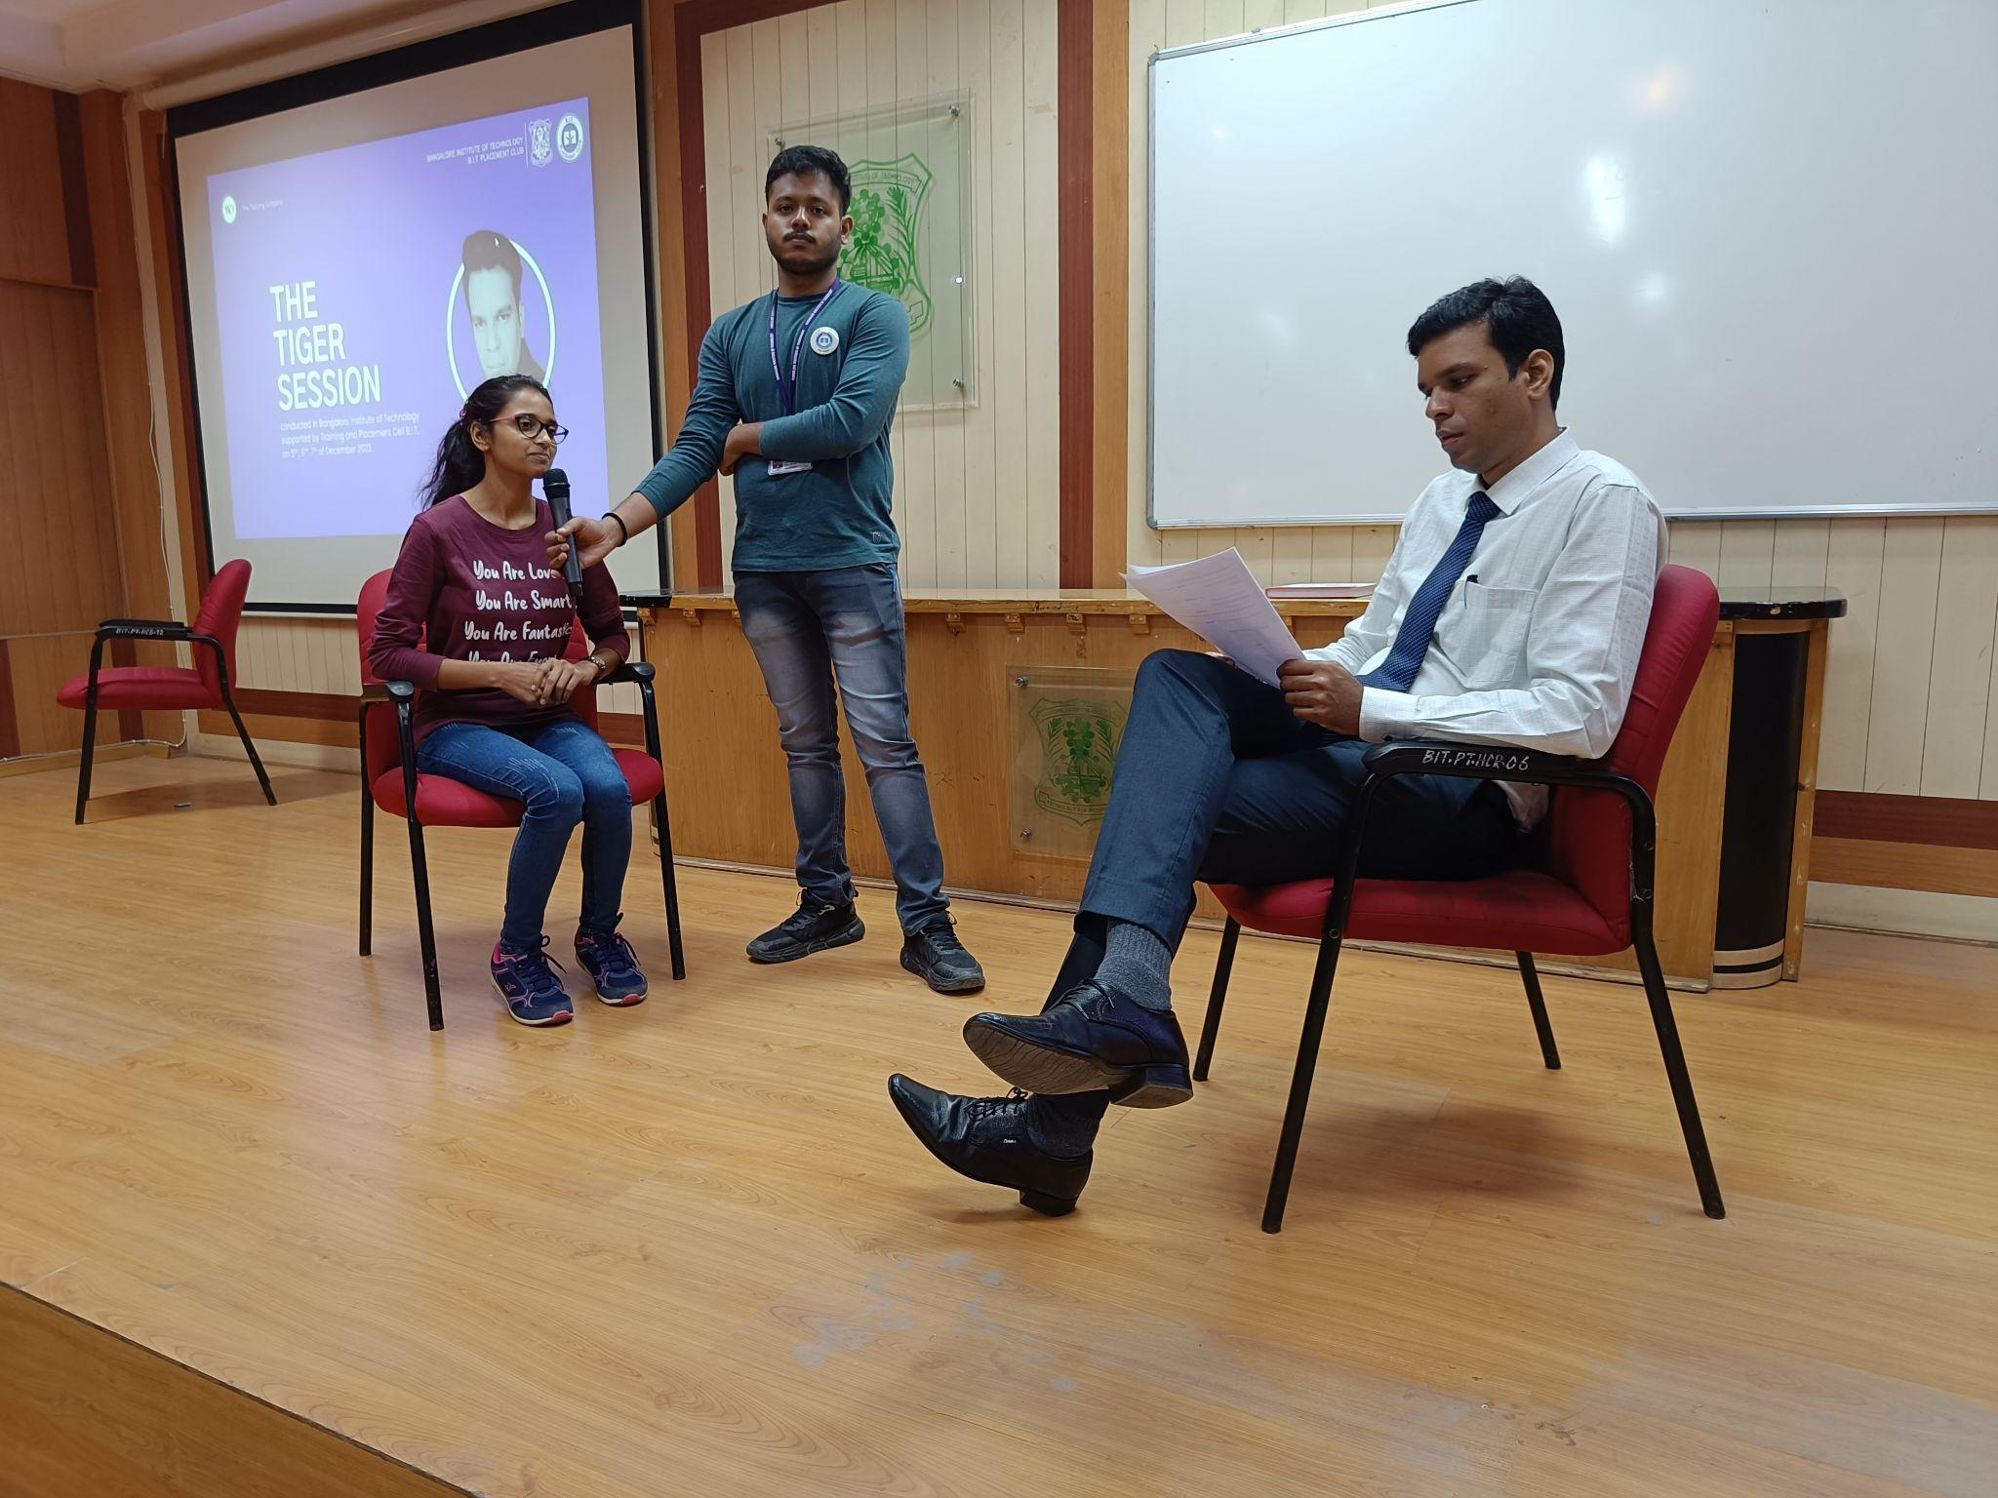
Our
Events!

Slide 5
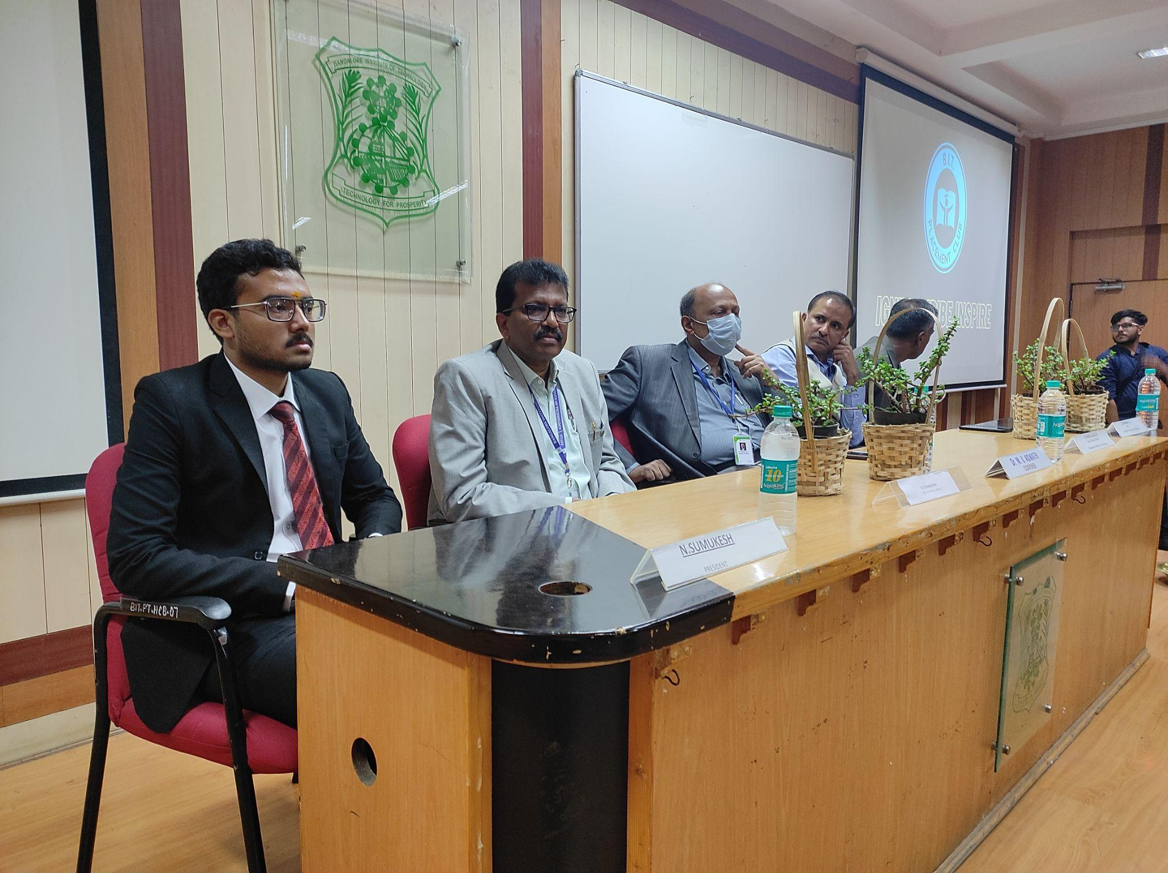
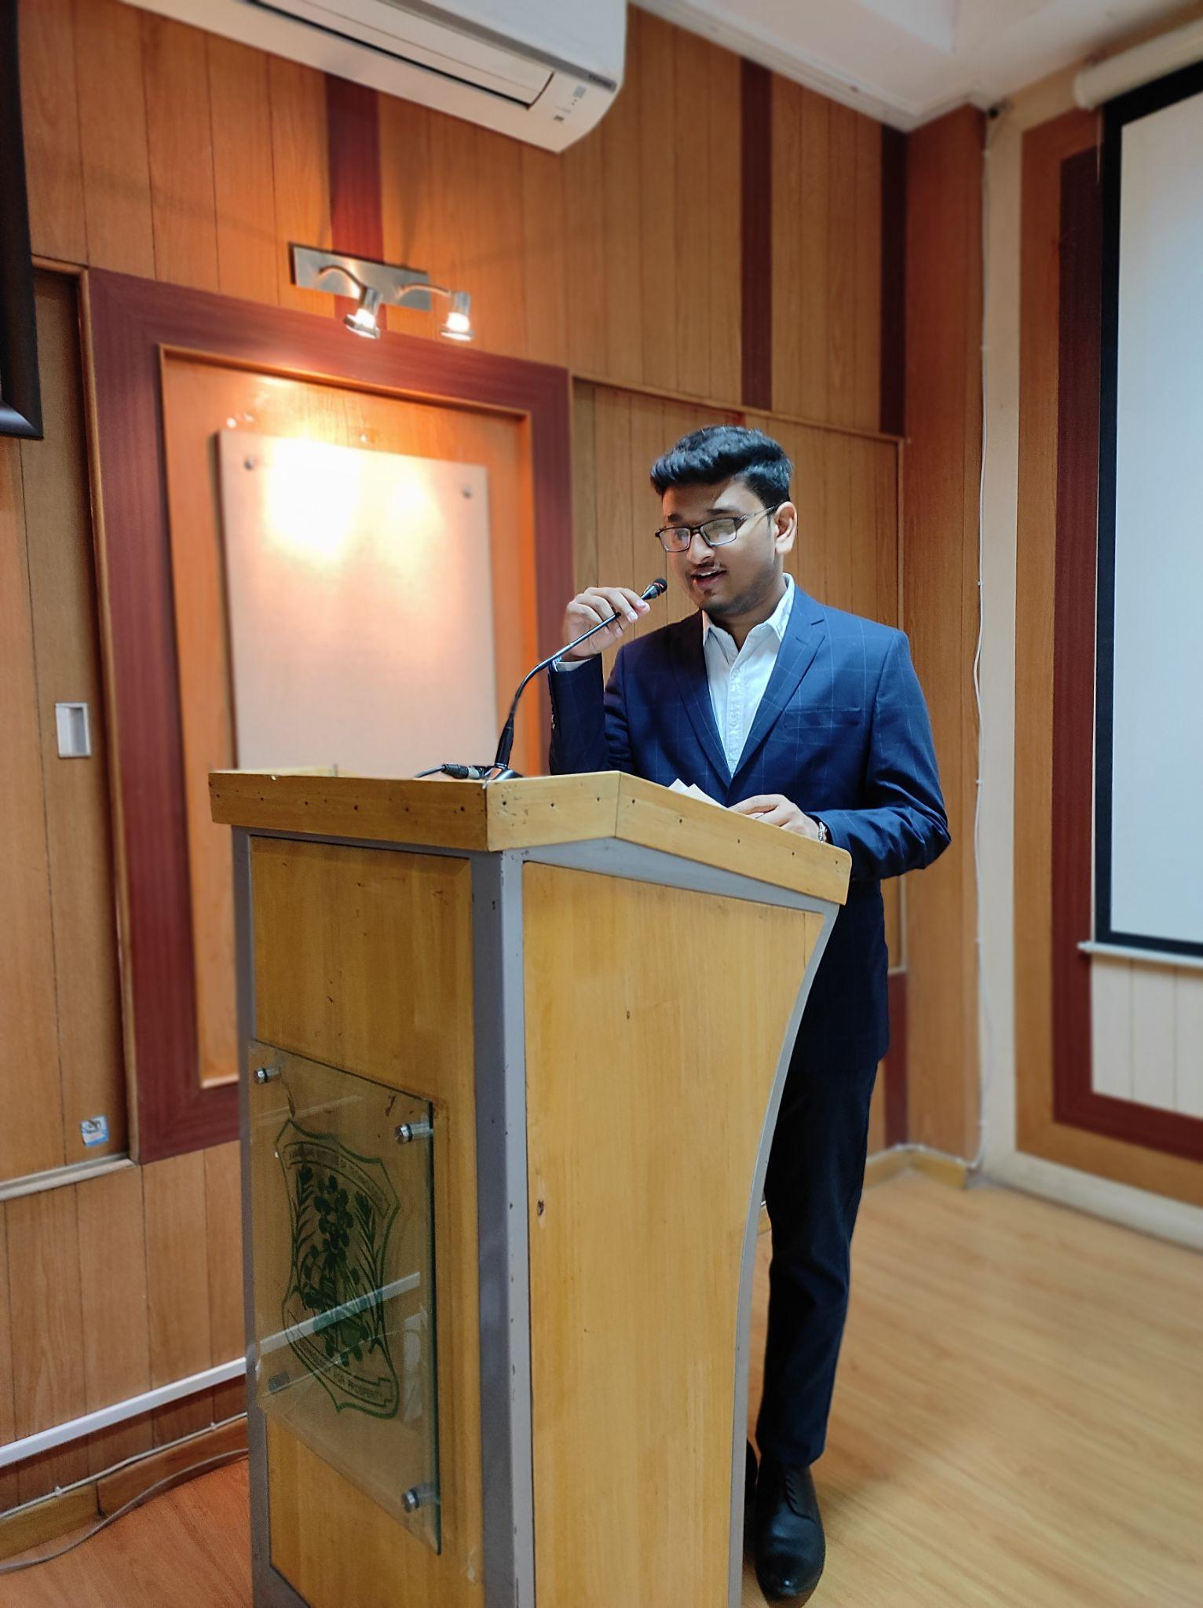
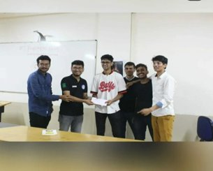
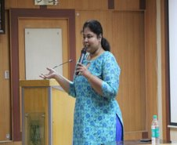
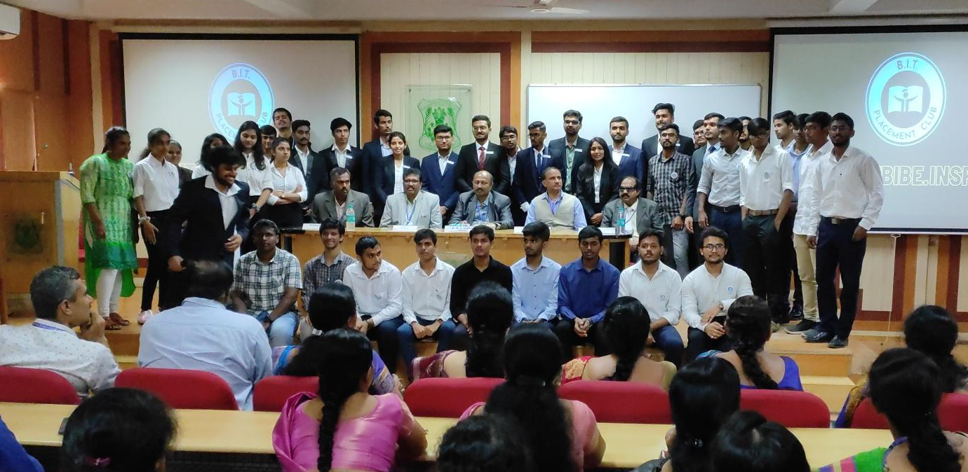
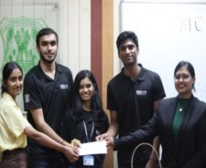
Little
Gallery!

Slide 6
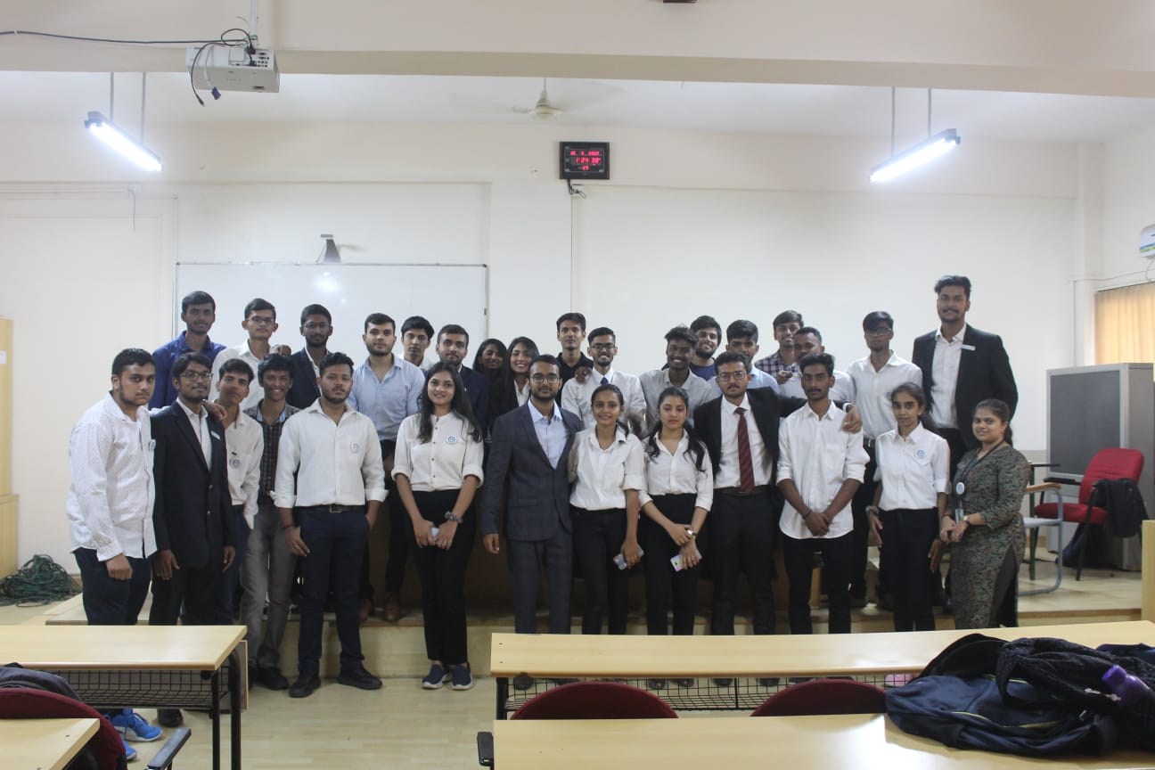
A catalyst for growth, connection, and success.

Slide 7
Eine Zeitleiste funktioniert immer
Announcement
Application
Shortlisting
Interview Round
Board Review and Submission
Finalized List

Slide 8

Connect With Us
@BIT Placement Club
@bitplacementclub

